Slide 1
The Importance of Training:
Training for Impact
Shelbi Nelson - Maryland
Doug Eckert - Oklahoma

Slide 2
Devotional
&
Opening Prayer

Slide 3
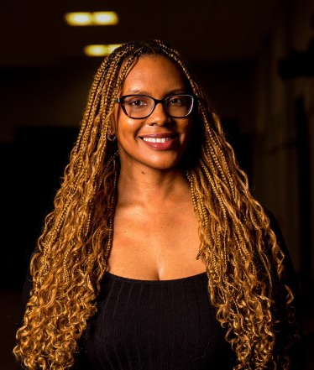
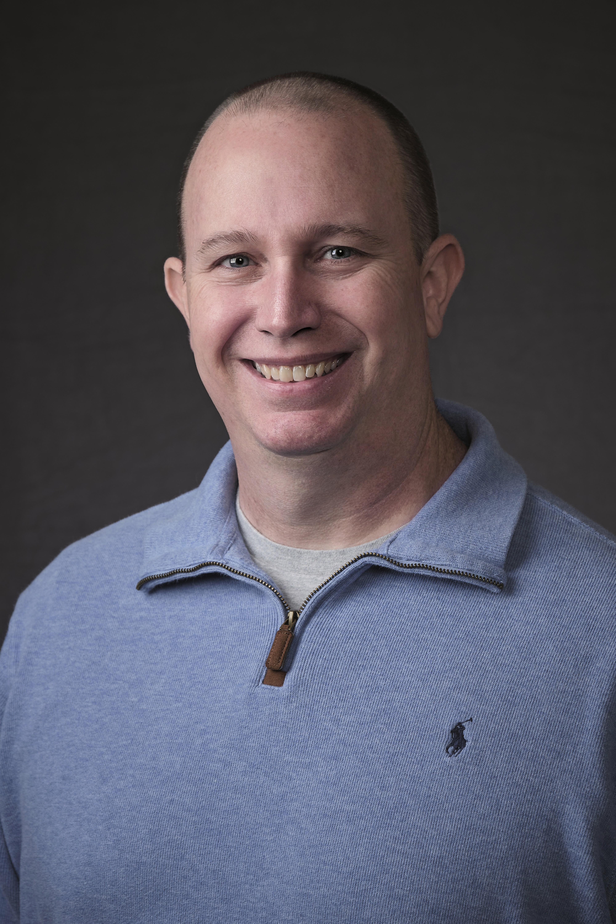
Meet Your Presenters
Shelbi Nelson
Doug Eckert

Slide 4
Prepare Properly Through Training
Manual resources
Role specific training
  Weekend
  Advisory Council
  State Chapter Committee and beyond
Virtual training available on mykairos.org

Slide 5
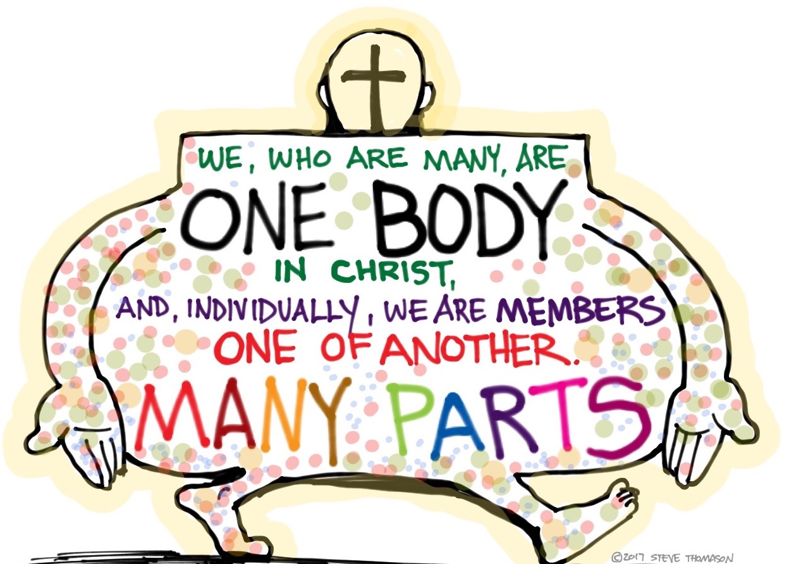
Volunteers are “part of the body”
  No position more important than another
Where do we go to get answers?
  Program Manual
  Advanced Kairos Training
  Kairos policies and procedures
  Team leaders as resources
  Virtual training
    Continuing ministry
    Advisory Council training
  Kairos Prison Ministry International staff

Slide 6

Group Dynamics – Impact On Training?
Inclusion
Power & Control
Affection
Effectiveness
Notes:
Vital part of process – need to train more during team formation -

Slide 7
Group Dynamics (Continued)
How does it play out with participants?
How does it play out with team members?
Notes:
Using this slide so that you can talk about the fact that team members need to be trained to understand how it plays out with participants/team members
Planning to talk about the importance of training this so the team understands how group dynamics impacts the Weekend for all programs – and the fact that the Weekend is laid out in such a way that it allows Group Dynamics to play out – if we follow the program the Participants for all three programs progress through Group Dynamics, and get to the place we desire them to be… ready for change etc.

Slide 8
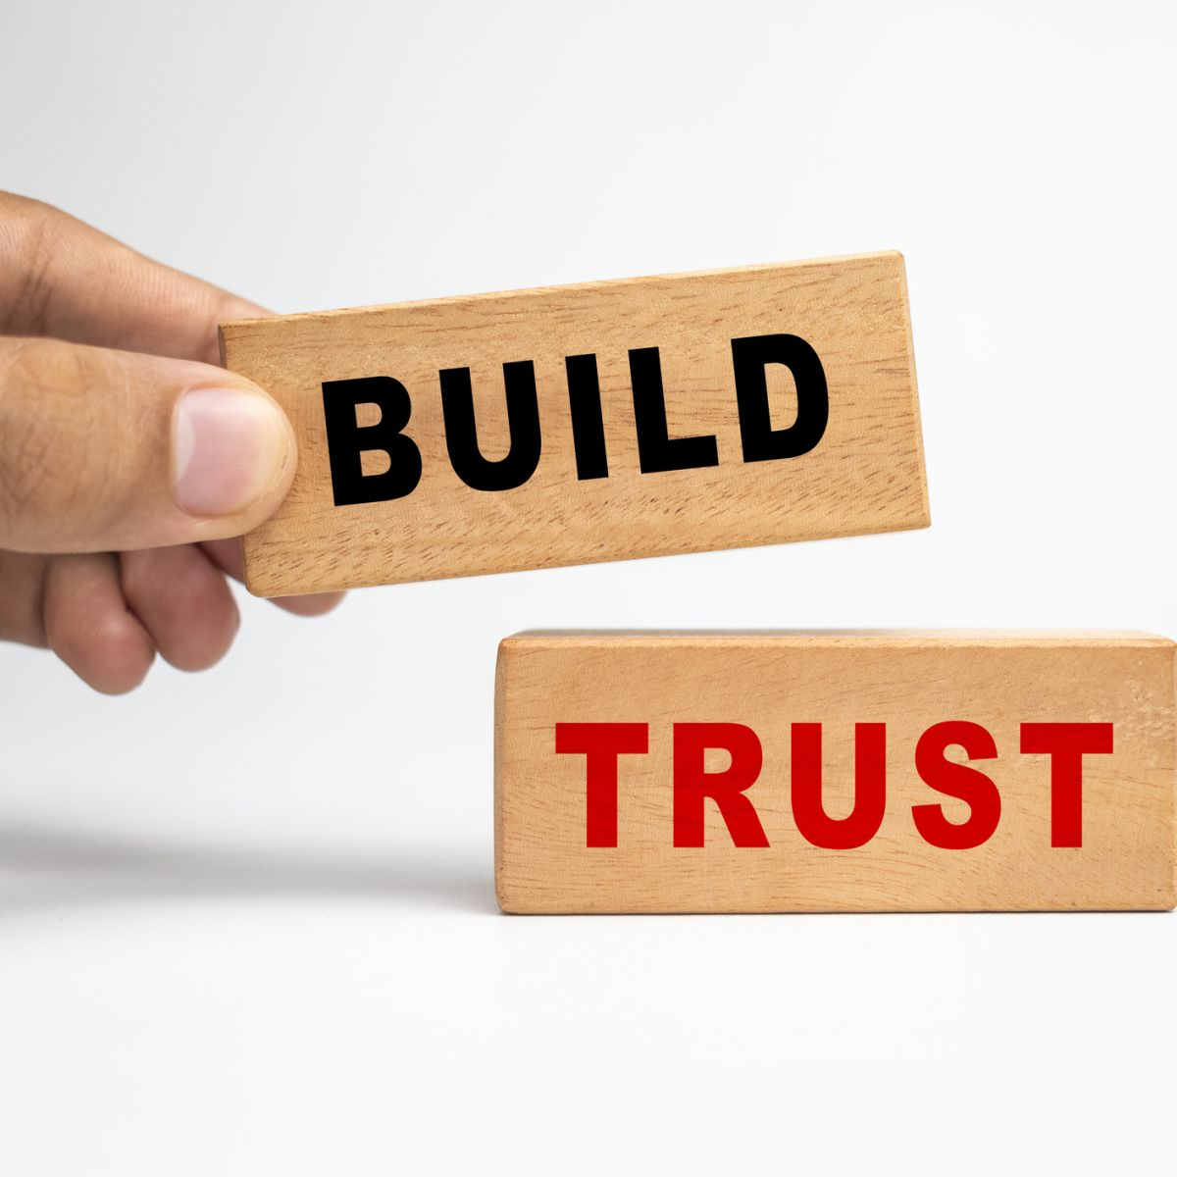
Why Is Training So Important?
Trust & vulnerability
Creates an environment of empowerment
Cuts down on confusion
Builds up future leaders
Builds trust in the program / ministry

Slide 9
Consistency
Why has Kairos survived 50 years?
Handwritten notes from the founders
Foundations
Manuals

Slide 10

Creativity in Training
Riverbanks are wide
Ezra says what to train, not how to train it

Slide 11
Questions
&
Answers

Slide 12
Thank
You!

